Slide 1
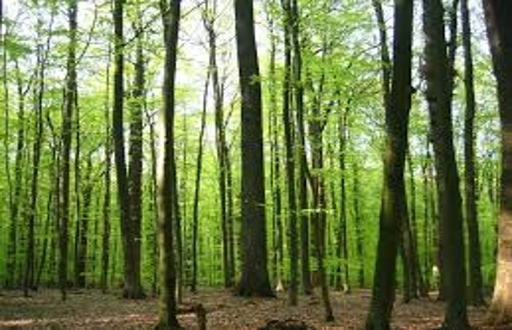
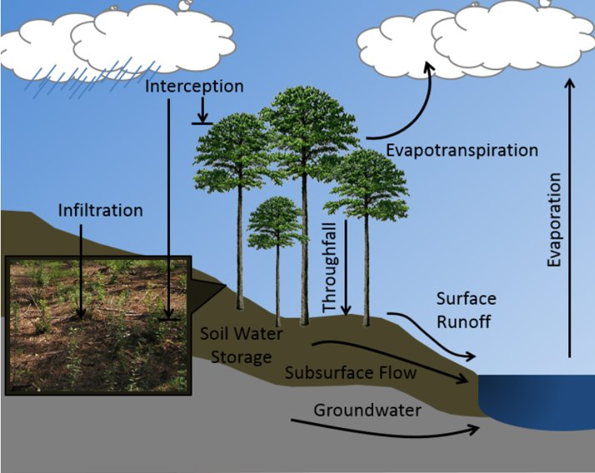


Module 4:
Water & Nutrient Cycling in Forestland Soils

Slide 2

But first,
a reminder:

Slide 3
Overview:
Water and nutrient cycling in forestlands share some common characteristics that are found in cropland, but there are some notable differences, also.
This module will focus on the general characteristics of both water and nutrient cycling in forestlands, with attention to how these are impacted by forest soil health.
Notes:
Part 1. Water cycling in forestland ecosystems: Forest hydrology in relation to forest soil health.

Slide 4
Part 1. Water Cycling:
Forest hydrology and soil health
Acknowledgment:
Material for this presentation was provided by Dr. James Vose,
Former Forest Ecologist, U.S. Forest Service Southern Research Station
Notes:
Part 1. Water cycling in forestland ecosystems: Forest hydrology in relation to forest soil health.

Slide 5
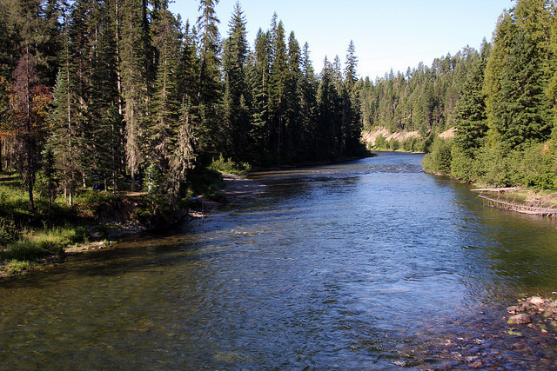
National Forest Foundation
3 Key Points:
Healthy soils are an integral part of forest hydrology that contribute to a stable supply of high-quality water.
Several watershed features play important roles in regulating forestland hydrologic processes.
Forest management factors that affect soil health also affect water yield and water quality.

Slide 6

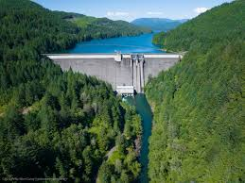
Background on soils, forests, and water
What we know…
The cleanest and most regulated supplies of water come from forested landscapes with healthy soils.
Forests can be managed in ways that protect soil health and water resources.
About 60% of our nation’s drinking water originates from forests.
              (Vose, 2014)
Kestrel Land Trust
Peter West Carey

Slide 7

Forest Hydrology Review
What attributes make forested watersheds so valuable for supplying clean water?
Texas A&M University
Notes:
Part 1. Water cycling in forestland ecosystems: Forest hydrology in relation to forest soil health.

Slide 8
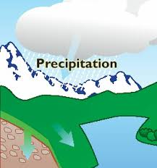
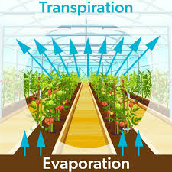
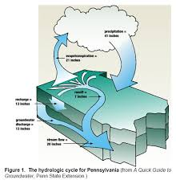
Key Watershed Processes
Inputs:
  Precipitation (rain and snowmelt)
Vegetation-soil-water interactions:
  Evapotranspiration
  Overland flow
  Percolation
Outputs:
  Streamflow
  Groundwater

Slide 9
Soil Health influences water balance
Healthy soils capture and store more water than soils with poor health.
Once water enters the soil, the amount of water that is available for streamflow, water table, and groundwater recharge is regulated by the soil.
Soils that are well-aggregated, uncompacted, high in organic matter, sufficiently covered by vegetation or plant litter, and have a network of living roots will store more water. This reduces runoff and evapotranspiration.

Slide 10



Interception vs. Infiltration
Some rainfall that interacts with leaves, branches, and stems can evaporate before it ever reaches the forest floor:
  10-15% in hardwood forests
  15-25% in conifers
Most water that reaches the forest floor is throughfall and stemflow.
This water can either infiltrate or run off, depending on the conditions in the forest floor.

Slide 11
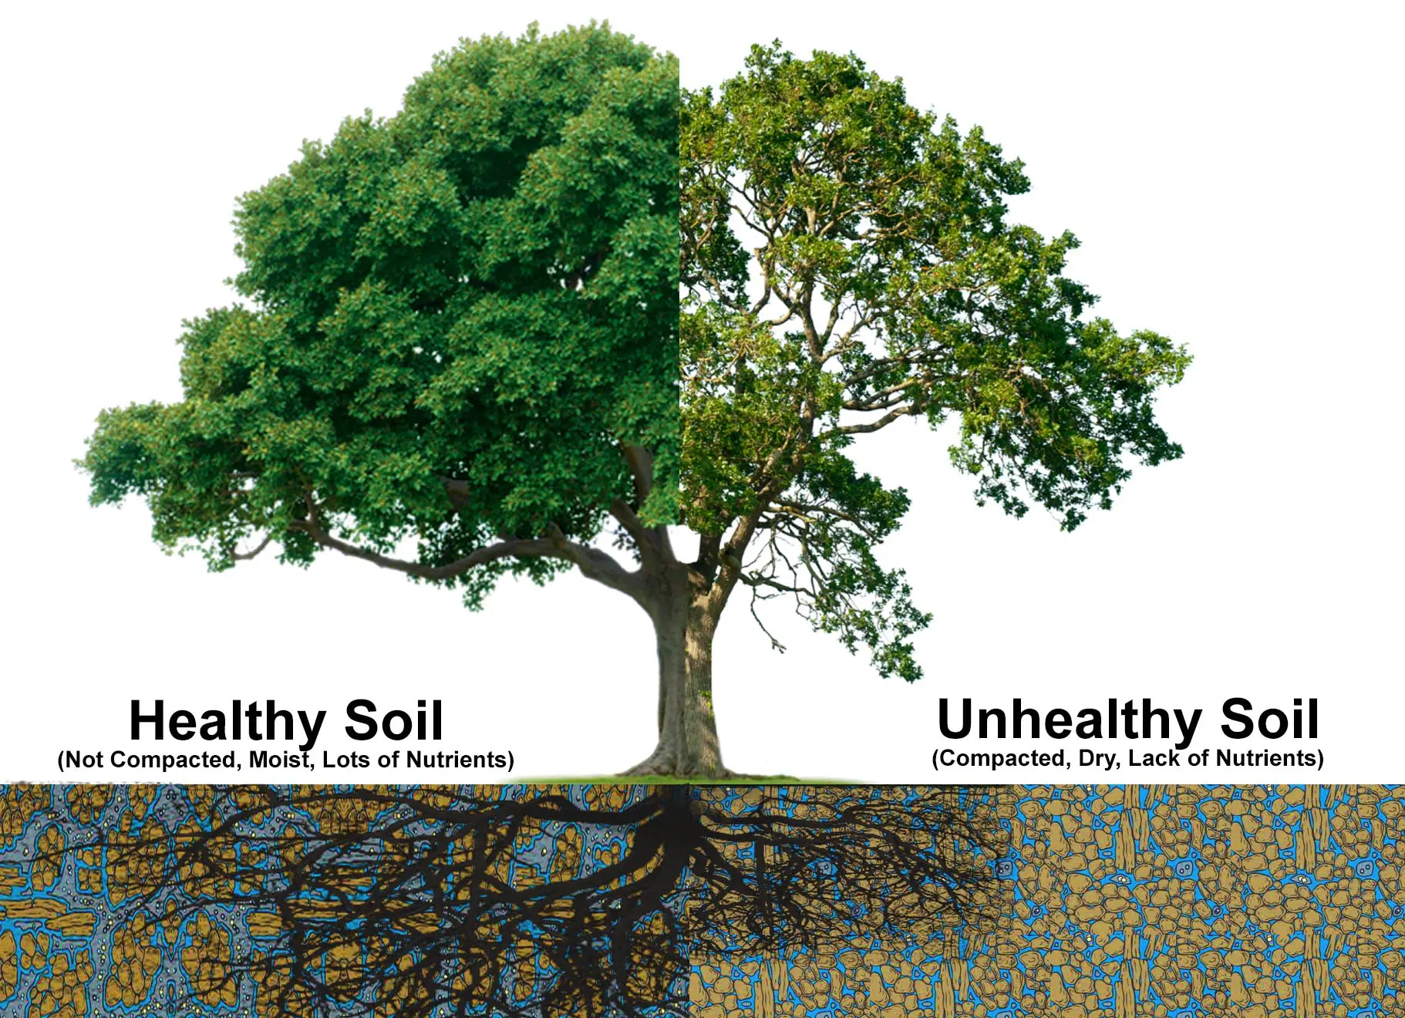
Forest floor, Soil characteristics, Infiltration
Litter Layer Thickness
Root presence, distribution, depth *
Soil Texture
Antecedent Soil Moisture
Soil Organic Matter *
Compaction- presence and degree *
Soil Aggregation *
* Properties related to soil health.
RTEC treecare

Slide 12
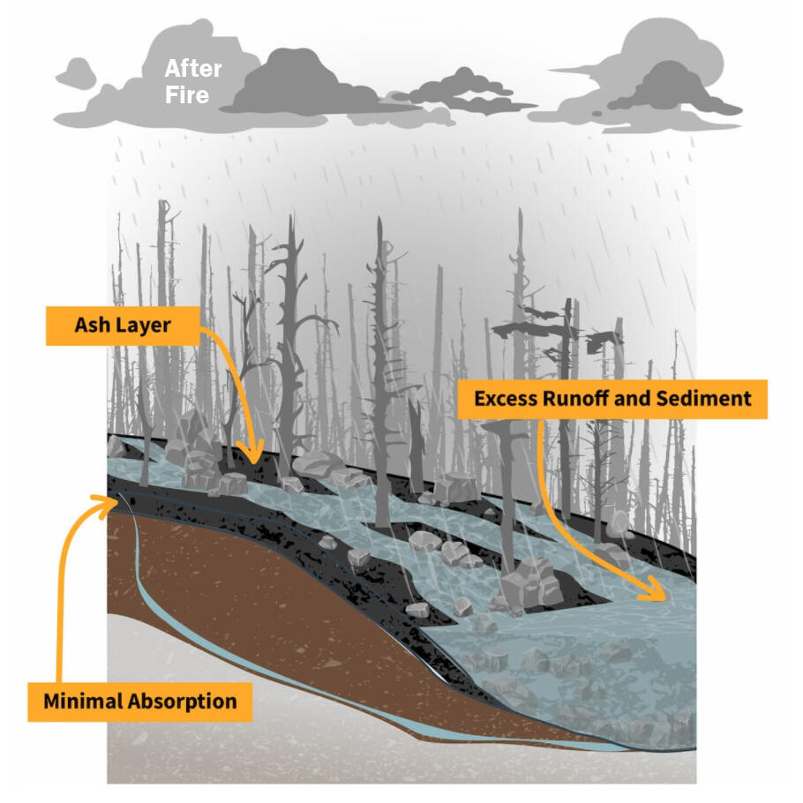
When infiltration just can’t happen…
In many forests, infiltration rates are high enough that there is seldom overland flow.
Exceptions:
    During high intensity rainfall.
    Rapid snowmelt.
    On disturbed sites such as those with compacted soils or following high intensity burns.
USGS

Slide 13
Transpiration Losses
Vary by:
  Tree and understory species
  Time of year
  Weather
  Tree age and size
Constitutes a large share of the water budget!
  A 12” tree can transpire up to 30 gallons of water per day.
                (Vose, 2014)

Slide 14
Transpiration Varies
Vegetation Type | Transpiration (mm/yr)
Longleaf pine savannah | 244
Old field pine | 250
Upland oak | 313
Mixed pine hardwood | 450
Loblolly pine plantation (piedmont) | 490
Slash pine flatwoods | 563
Loblolly pine plantation (coastal plain) | ~900
Oak-pine-hickory | 278
Forest type, climate and soils
... AND management, all affect the rate of transpiration.
~900,000 gallons per acre per year!

Slide 15
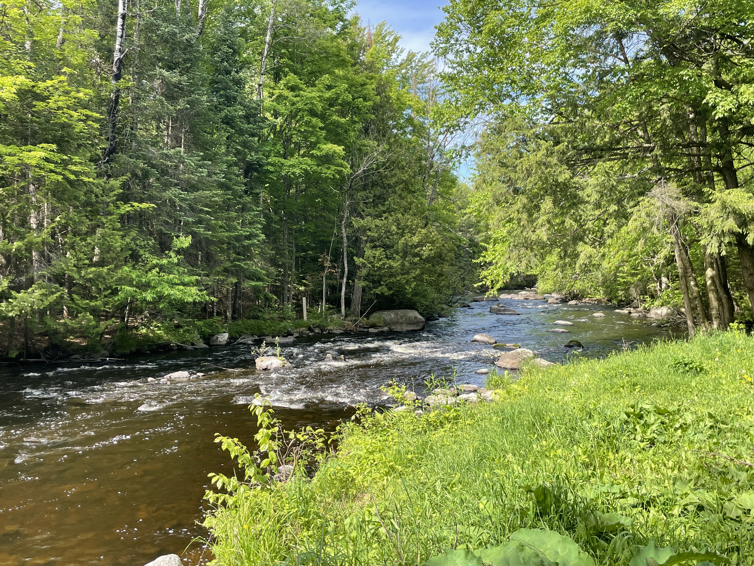
Soil Water Storage and Evaporation
Evaporation
In forest, forest cover and a thick forest litter layer minimizes soil evaporation.
Soil Water Storage
Forest soils act like a sponge, holding onto soil water and slowly releasing it to groundwater recharge and streams.
(Photo: M. Kopecky)
Notes:
Part 1. Water cycling in forestland ecosystems: Forest hydrology in relation to forest soil health.

Slide 16
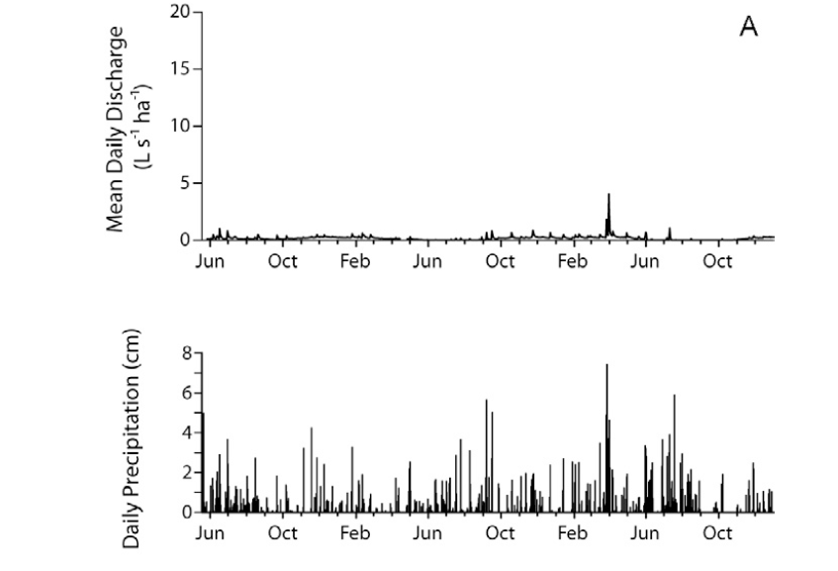
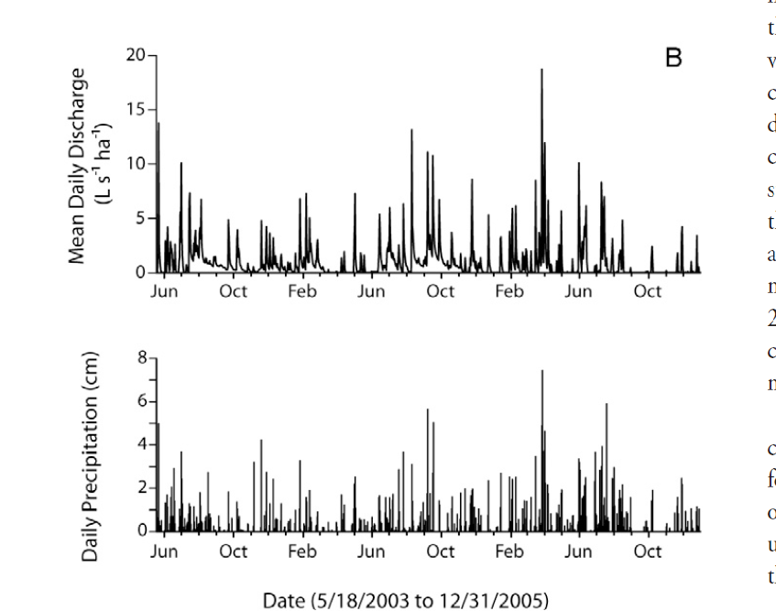
Examples of forested (A) and urban (B) hydrographs from west Georgia. Adapted from Crim (2007).
Notes:
Part 1. Water cycling in forestland ecosystems: Forest hydrology in relation to forest soil health.

Slide 17
Forest Hydrology Review
What attributes make forested watersheds so valuable for supplying clean water?
Texas A&M University
Notes:
Part 1. Water cycling in forestland ecosystems: Forest hydrology in relation to forest soil health.

Slide 18
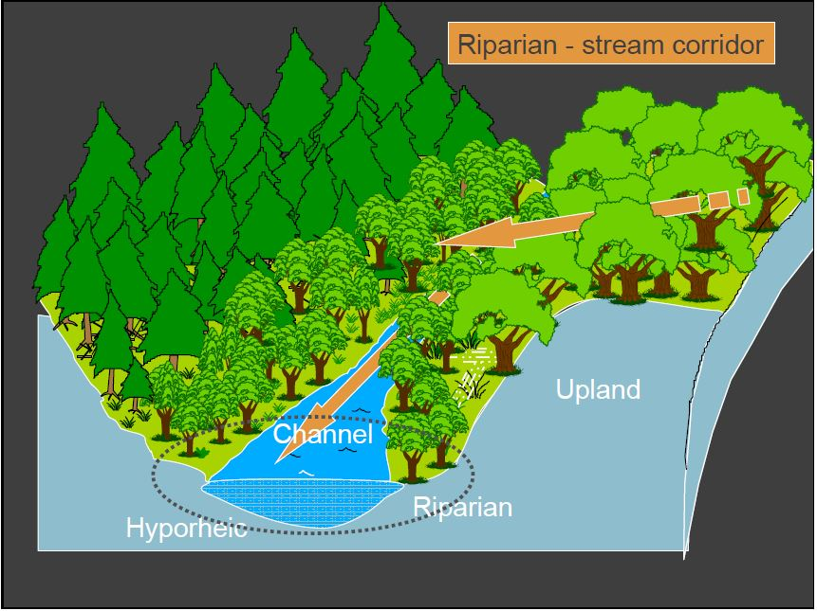
Riparian area: The critical interface between upland and stream
Sediment and nutrient filtering
Stream bank stabilization
Wildlife habitat, corridors
Wood and OM supply
Buffer for stream temperature
Biodiversity hotspot

Slide 19
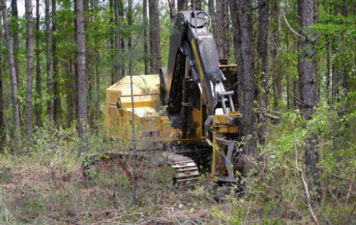
Effects of forest cutting on water yield
Stream flow increases in proportion to the amount of forest cut.
Responses after harvest vary depending on what vegetation regrows or is planted.
Stream flows decrease as the forest re-grows.
USFS

Slide 20
Effects of forest cutting on water quality
Cutting alone does not cause elevated erosion and stream sediment—it’s how you get the logs out of the woods.
Stream nutrient losses (especially nitrogen) are typically small and tightly controlled by vegetation re-growth.
USFS

Slide 21
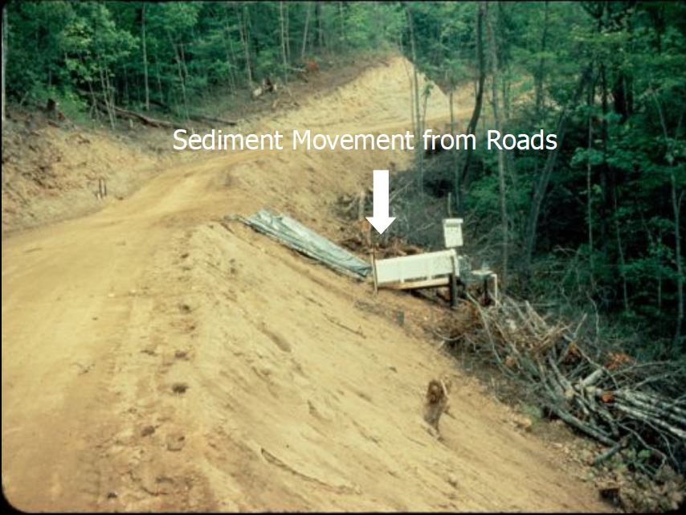
Forest management-related practices that impact soil health also can affect water quality: Haul roads
Erosion/ sedimentation
Disturbances:
  Loss of cover
  Loss of aggregation
  Compaction

Slide 22
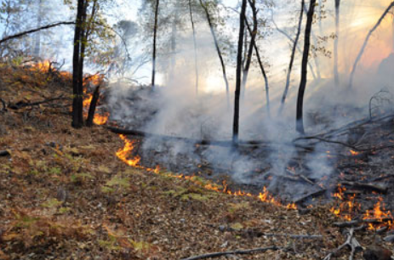
Fire effects on soil health also can impact water quality and quantity
Prescribed/ low intensity burns generally have minimal effect
Wildfire responses can be substantial depending on:
  Burn severity
  Post-fire climatic conditions
  Topography

Slide 23
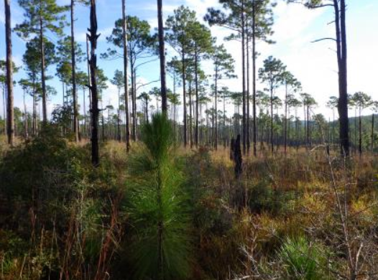
Soil health and watershed response factors after fire:
Infiltration rates*
Loss of forest floor*
Vegetation recovery*
Overstory mortality
Post-fire rainfall intensity
Topography
*Factors directly related to soil health

Slide 24
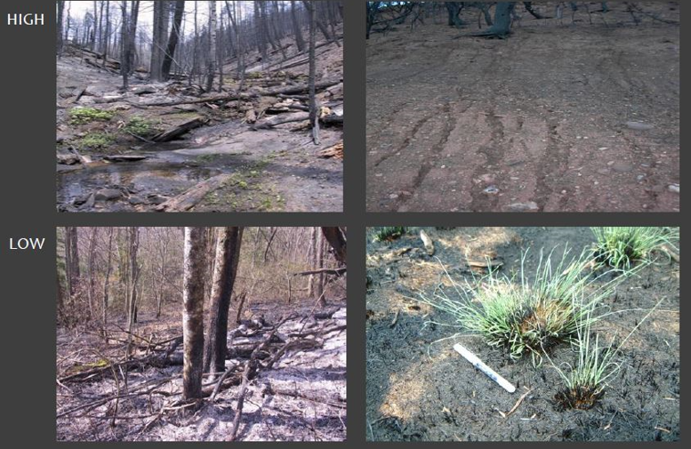
Erosion and sedimentation after fire
May be severe or negligible, depending on conditions.
USGS

Slide 25
Summary of 3 Key Points:
Healthy soils are an integral part of forest hydrology that contribute to a stable supply of high-quality water.
Several watershed features play important roles in regulating forestland hydrologic processes.
Forest management factors that affect soil health also affect water yield and water quality.
National Forest Foundation

Slide 26
Part 2. Nutrient cycling in forestlands
Key Points—Several general factors influence forestland nutrient cycling, including some directly related to soil health:
    Climate effects: Tropical, temperate, and boreal forests
    Biotic factors
    Abiotic factors
    Effects of disturbance:
      a. Fire
      b. Weather events
      c. Harvest effects
      d. Pest infestations
      e. Fertilization
Notes:
Part 1. Water cycling in forestland ecosystems: Forest hydrology in relation to forest soil health.

Slide 27
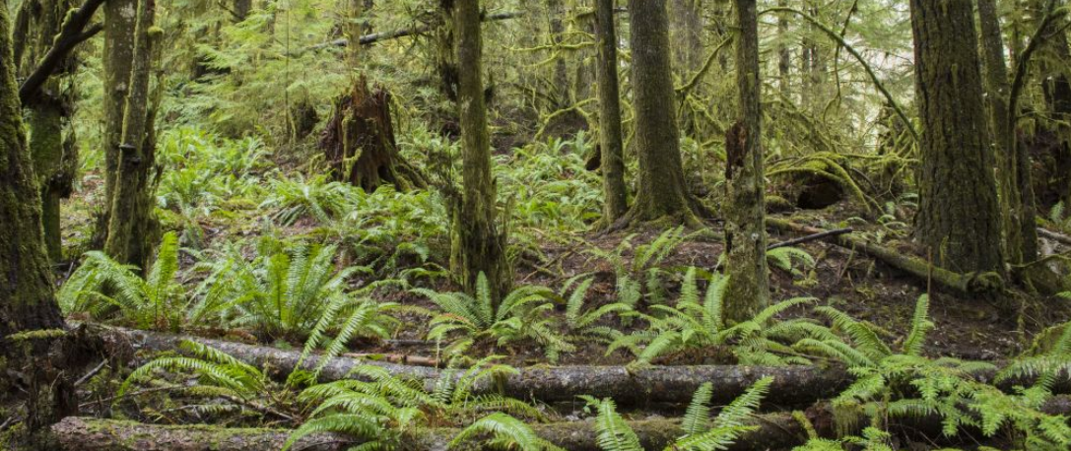
A generalization:
“More than half of the annual nutrient uptake by a forest is typically returned to (the) forest floor (litterfall) and soil (fine root turnover)".
(Foster and Bhatti, 2006)
Oregon State University
Notes:
Part 1. Water cycling in forestland ecosystems: Forest hydrology in relation to forest soil health.

Slide 28
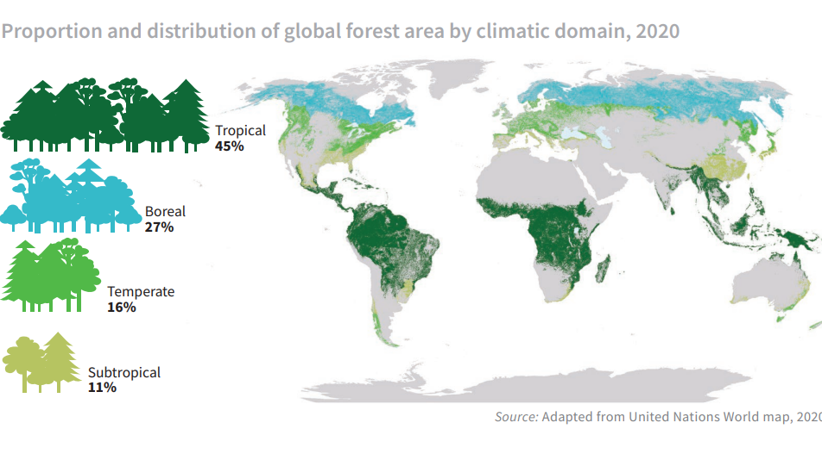
Forest types by climatic region
(Source: FAO)
Notes:
Part 1. Water cycling in forestland ecosystems: Forest hydrology in relation to forest soil health.

Slide 29

Climate effects & General trends in nutrient cycling by forest type
Tropical forests
  Usually found on highly weathered soils with low fertility.
  Often in areas of high rainfall coupled with high average temperatures.
  Typically have high proportion of total nutrients in above-ground vegetation.
  Typically characterized by low nutrient storage in forest floor and mineral soil.
  Litter is rapidly decomposed and returned to living vegetation (turnover rate 10x as fast as for boreal soils).
  Trends may be modified by periods of flooding or drought.
Wikipedia

Slide 30
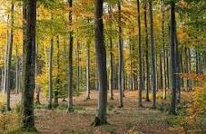
Climate effects & General trends in nutrient cycling by forest type
Temperate forests
  Usually found on young to moderately-weathers soils with wide range of fertility.
  Average annual temperature and precipitation vary according to region.
  Exhibit more balance in nutrient storage pools between soil, forest floor, and living vegetation.
  Nutrient storage varies across pools seasonally.
Trillium Montessori

Slide 31
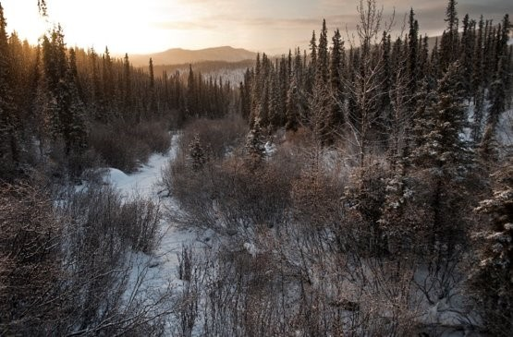
Climate effects & General trends in nutrient cycling by forest type
Boreal forests
  Typically found on young soils in cold areas with wide range of fertility.
  Tend to accumulate nutrients and organic carbon in the forest floor.
  Low temperatures and short growing seasons reduce microbial activity, decomposition/ mineralization, and primary production.
USFS

Slide 32
Biotic & Abiotic Factors Affect Nutrient Cycling
  Climate
  Tree and other species community effects
  Disturbance
  Microbial associations: help acquire N, P, and micronutrients and redistribute between individuals and species.
  Pests: Disease/ insect infestations:
  Invasive species
Notes:
Part 1. Water cycling in forestland ecosystems: Forest hydrology in relation to forest soil health.

Slide 33
Influence of Biotic Factors​
Tree and other species effects:
  Litterfall
    Litter decomposition/ nutrient mineralization often more rapid in hardwoods compared to conifers.
    Species vary in resource- (water and nutrient) use requirements and efficiency
    Characteristics of litter:
      Quantity and quality vary between species
      Branches and boles more recalcitrant than leaf/ needle litter
  Nitrogen dynamics (can include abiotic influence if stand is fertilized)
    N fixation (Rhizobia, Frankia, free living N-fixers)
    N limitation is weak in tropical forests with high rates of mineralization but increases in temperate and boreal systems.
Notes:
Part 1. Water cycling in forestland ecosystems: Forest hydrology in relation to forest soil health.

Slide 34
Influence of Biotic Factors​
Tree and other species effects, continued:
  Mycorrhizal associations:
    Help acquire N, P and micronutrients.
    Redistribute those between individuals and species.
  Pests: Disease &/or Insect infestations:
    Tree death.
    Interruption of ecological homeostasis.
  Rhizophagy
  Invasive species
Notes:
Part 1. Water cycling in forestland ecosystems: Forest hydrology in relation to forest soil health.

Slide 35
Influence of Abiotic Factors
Climate
Soils
Fire
Mechanical disturbance
  Harvesting (also biotic)
  Storm damage
  Flooding
  Landscape evolution (meanders, landslides, etc.)
Fertilization (also biotic)
Notes:
Part 1. Water cycling in forestland ecosystems: Forest hydrology in relation to forest soil health.

Slide 36
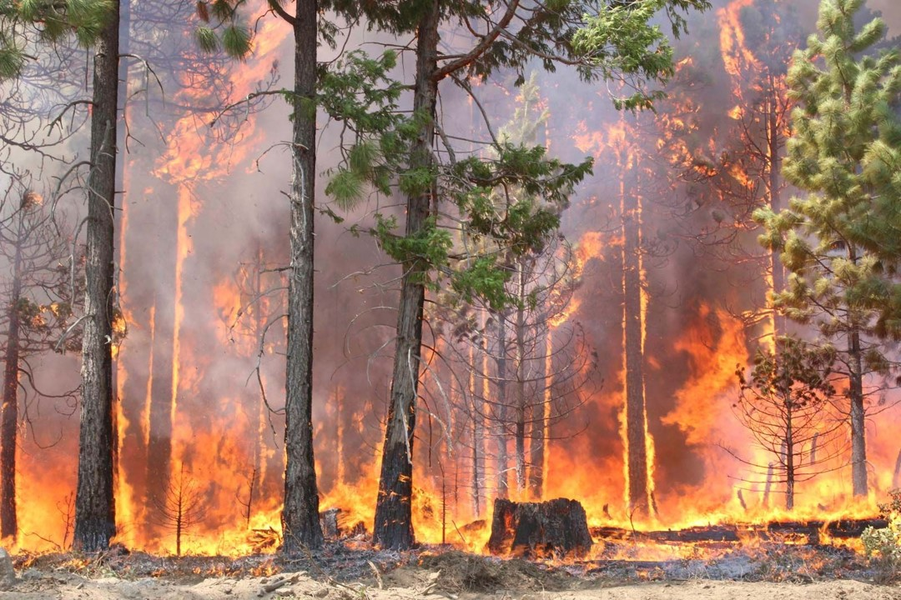
Disturbance: Natural vs. Human
Fire (Abiotic)
  Horizontal and vertical redistribution of nutrients:
    Oxidation/ volatilization of live tissue and other organic matter.
    Convection and aerial redistribution of ash.
    Physical movement by water/ wind erosion.
    Percolation and lateral flow of dissolved nutrients through and out of soil.
  Changes in mineral nutrient cycling
    Near-instantaneous loss of N and S, mineralization of other nutrients
    Liming effect of ash
Brittanica; USFS

Slide 37
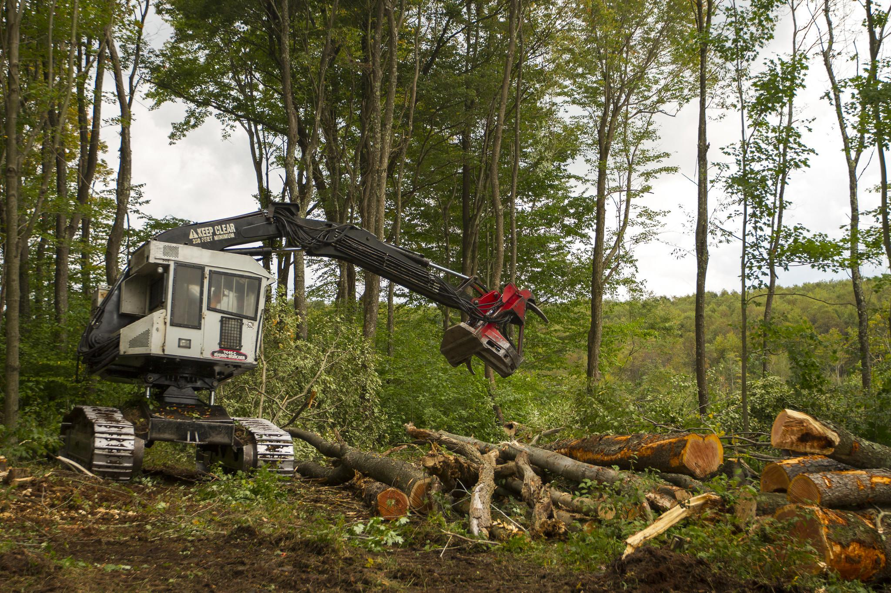
Disturbance: Natural vs. Human
    Harvesting
    Physical removal of nutrients from system.
    Whole tree vs. stemwood harvests.
    If removal exceeds the soil’s capacity to maintain growth, it may be necessary to fertilize.
    May result in physical damage to soils—rutting, compaction, erosion.
    Interrupts nutrient cycling (temporary).
    Revegetation times vary—months in tropics, 2-5 years in temperate forests, longer in boreal forests.
Notes:
Part 1. Water cycling in forestland ecosystems: Forest hydrology in relation to forest soil health.

Slide 38
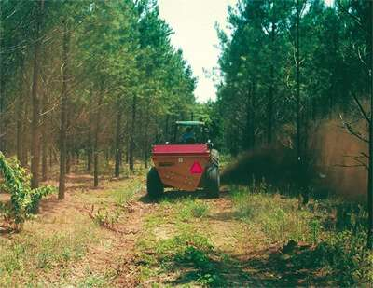
Disturbance: Natural vs. Human
  Fertilization (biotic & abiotic)
  Often focused on nitrogen and phosphorus.
  Has been studied and practiced on a variety of forest types.
  More common in high value and rapidly growing stands:
    Plantations (SE, NW)
    Nurseries
    Christmas tree plantations
  Also as a disposal option for municipal biosolids in some areas.
Notes:
Part 1. Water cycling in forestland ecosystems: Forest hydrology in relation to forest soil health.

Slide 39
Forestland nutrient cycling summary
There are general differences in forestland nutrient cycling by climatic region: tropical, temperate, boreal.
Biotic factors are important influences on nutrient cycling: species effects, litter production/ quality, N dynamics, and microbial interactions.
Natural and human-induced disturbances often interrupt or alter nutrient cycling in forestlands: fire, harvesting, weather events, disturbance, fertilization.
Notes:
Part 1. Water cycling in forestland ecosystems: Forest hydrology in relation to forest soil health.

Slide 40
Thank you!
For more information on Managing Soil Health,
visit us here:
https://www.nrcs.usda.gov/conservation-basics/natural-resource-concerns/soils/soil-health
USDA is an equal opportunity provider, employer, and lender.

